Slide 1
Calorie Tracker Using Django
Title: Calorie Tracker Web Application
Subtitle: A Simple Django-based Calorie Tracking System
Presented by : Shifana A

Slide 2
Project Overview
Objective: Create a web application to track users' calorie intake based on their meals.
Features:
Add food items with calorie data.
Log meals by selecting food items.
View total calories consumed for each meal.
Display overall calorie consumption.
Tech Stack
Frontend: HTML, CSS, Django Templates
Backend: Django Framework (Python)
Database: SQLite (default Django database)

Slide 3
Key Models
Category Model:
Represents different food categories (e.g., Breakfast, Lunch, Dinner, Snacks).
Fooditem Model:
Stores details of food items, including calories.
Linked to a specific food category.
Customer Model:
Stores user-specific information.
Represents a relationship with a user.
UserFooditem Model:
Many-to-many relationship between users and food items they log for calorie tracking.

Slide 4
Key Views & Logic
Home View (Admin Panel):
Displays food items from different categories (Breakfast, Lunch, Dinner, Snacks).
Displays customer data.
Fooditem View:
Allows admin to view all food items and manage them.
Create Fooditem View:
Form to add new food items (only accessible to admins).
User Page:
Allows users to view their logged food items and track total calorie consumption.
Displays remaining calories based on the 2000-calorie daily limit.
Add Fooditem for User:
Allows users to log new food items and track their calories.

Slide 5
Code Structure
Views:
Home: Admin panel showing food items and customer details.
Fooditem: Admin view for managing food items.
Createfooditem: Admin view for adding new food items.
RegisterPage: User registration view.
LoginPage: User login view.
UserPage: User dashboard for viewing and adding food items.
AddFooditem: View for users to add food items.
Forms:
Food Item Form: Form for creating and updating food items.
Add User Fooditem: Form for users to log food items.
Create User Form: Form for user registration.
Filters:
Fooditem Filter: Allows users to filter food items by name and category.

Slide 6
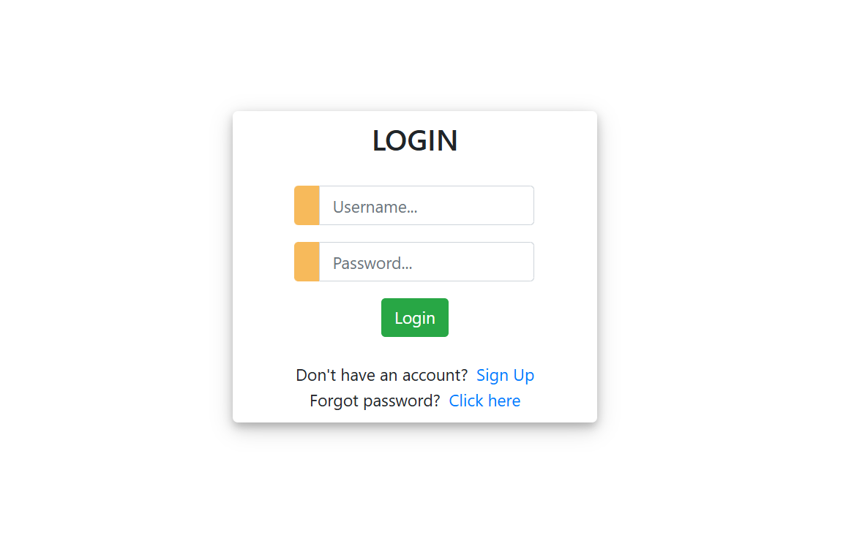

Slide 7
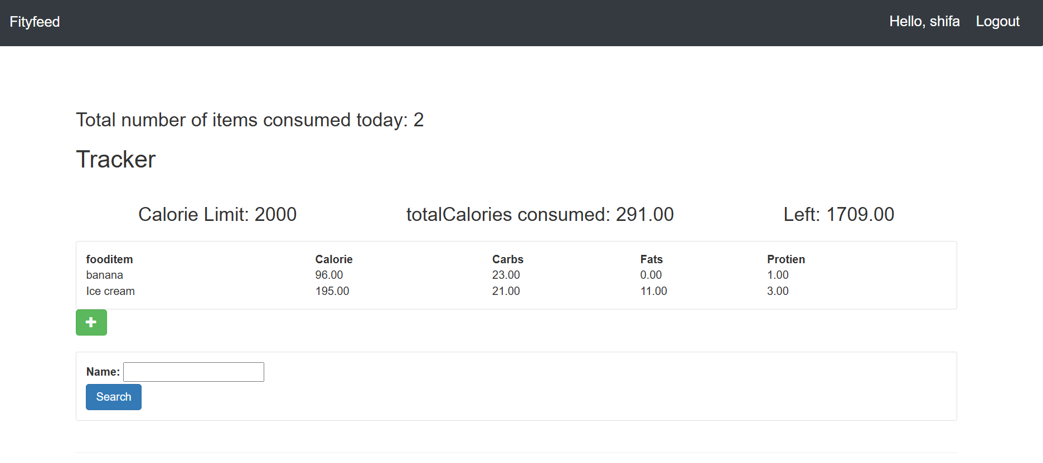

Slide 8
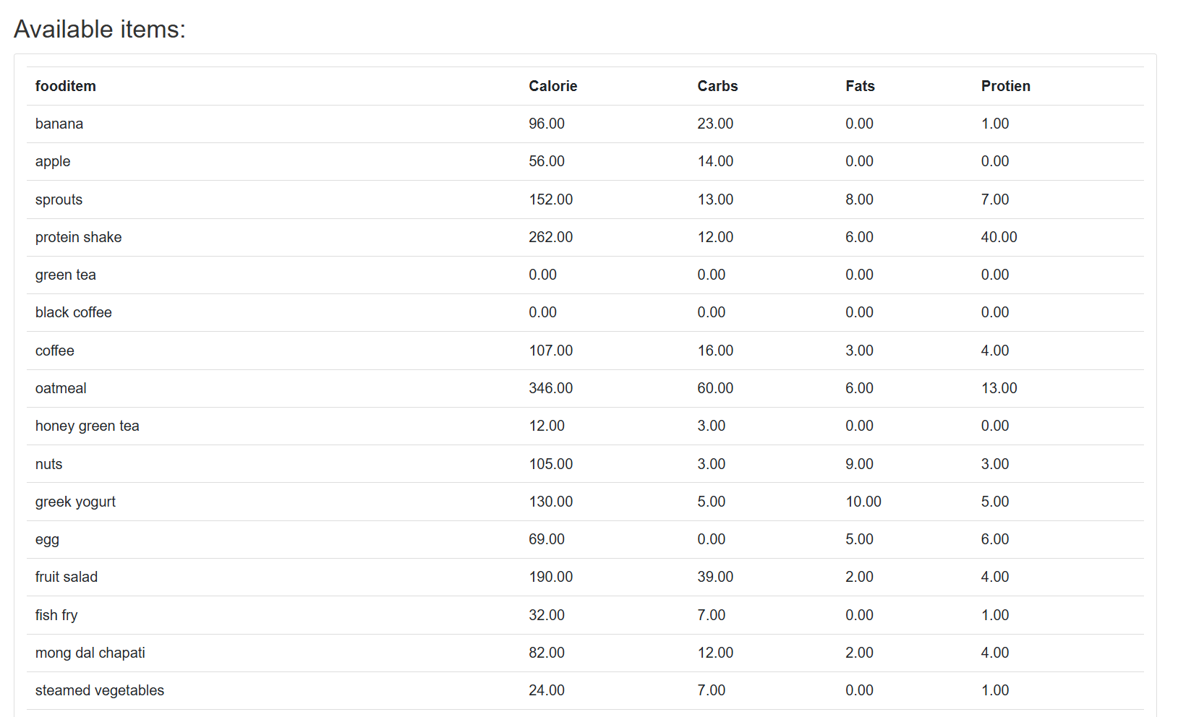

Slide 9
Future Enhancements
User Profile: Allow users to set personal calorie goals.
Food Item Nutritional Info: Include more details like protein, fat, and carbs.
Daily/Weekly Reports: Generate reports of the user's calorie intake over time.
Mobile Version: Optimize the application for mobile use.
Conclusion
Outcome: Developed a Django-based calorie tracking web application.
Key Features: User registration, food item management, calorie tracking, role-based access.
Future Scope: Enhance functionality with user-specific reports and mobile optimization.

